Slide 1
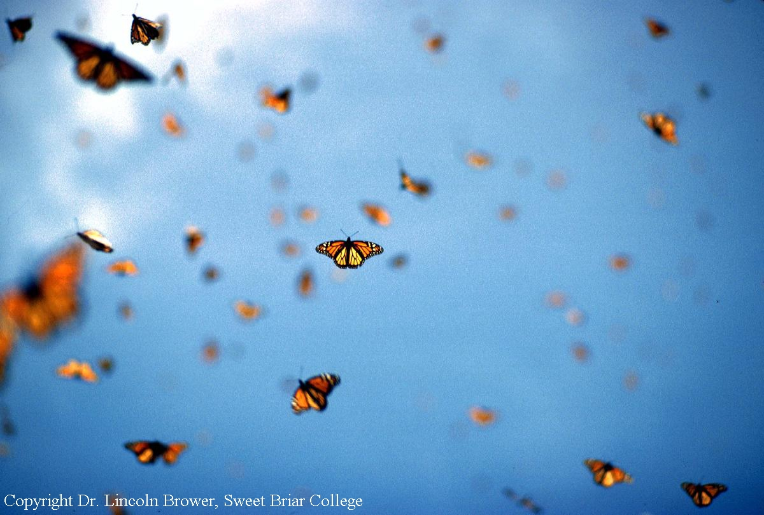
Using math to save monarch butterflies!
Rockwern Academy
February 3, 2025
Notes:
Hi everyone! We’re going to be investigating monarch butterflies for this lesson. We’ve got data that scientists gathered, and we can use math to see how the species is doing and how our decisions affect their populations

Slide 2

The monarch’s annual cycle
Spring Migration & Breeding
Summer Breeding
Notes:
You might be familiar with the monarch butterfly. They can be found here in Ohio in the summer, but right now, they’re all in Mexico!
In a few months, they’ll start migrating north to Texas and the southern US, where they’ll have babies.
Then, in early summer, those babies will fly north to the summer breeding grounds in Ohio, Michigan, and a good chunk of the Midwestern US. They’ll spend a few generations here – have babies, grow up, the cycle continues.

Slide 3
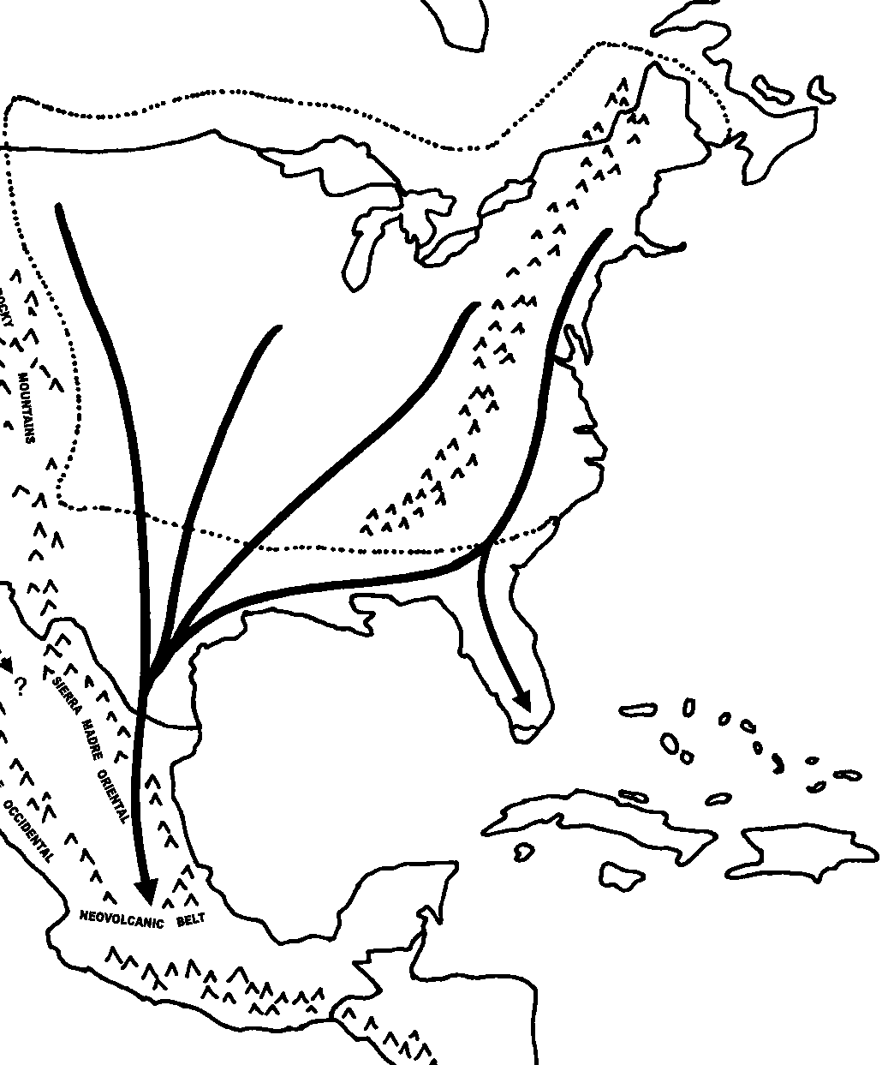
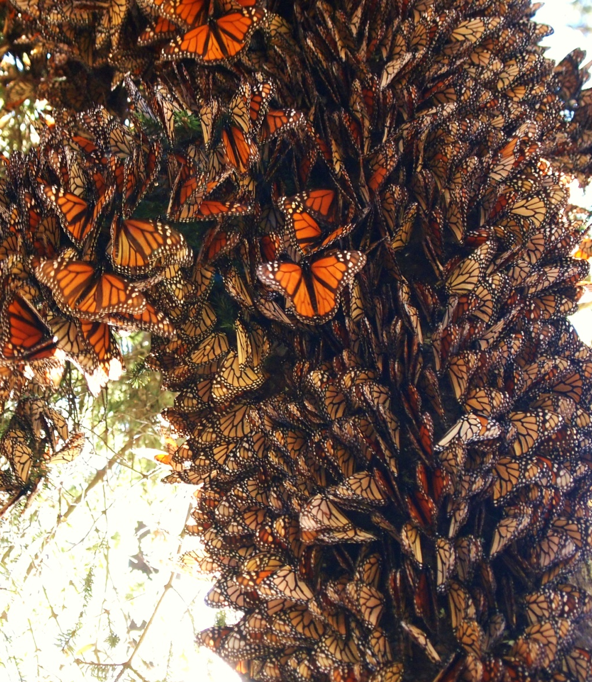
The monarch’s annual cycle
Fall Migration
Notes:
But, the butterflies born in September will be a bit different! They won’t lay eggs and reproduce yet, and they’ll be a bit larger so that they can fly all the way back to Mexico, where the current monarchs are now!
2,500+ mile journey; reproductive diapause

Slide 4

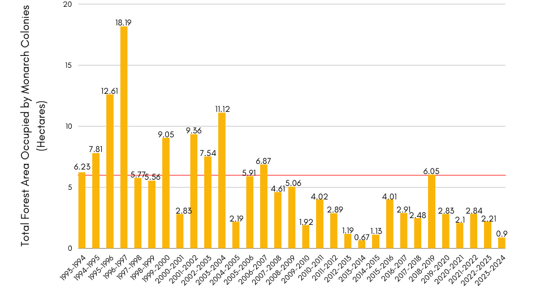
Monarch population decline
Notes:
These really cool butterflies have undergone a decrease in population over the past decades. The years are on the x, while the space they occupy in Mexico is on the y axis – they all clump together so it’s not possible to count individuals like you did with the penguins, so they count the amount of space taken up instead. The red line indicates the target population size – ideally, most or all years would have at least this big of a population for us to feel good about their ability to survive into the future. As you can see, the size has decreased over time and is very low right now.

Slide 5
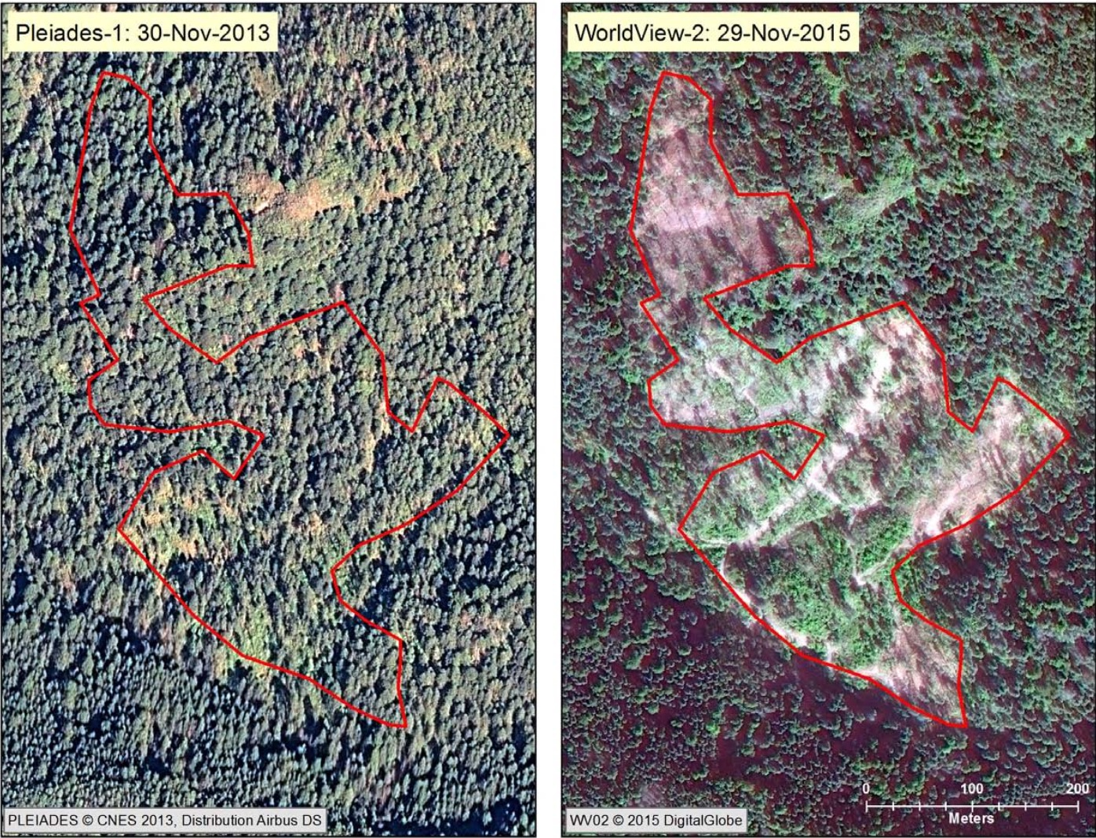

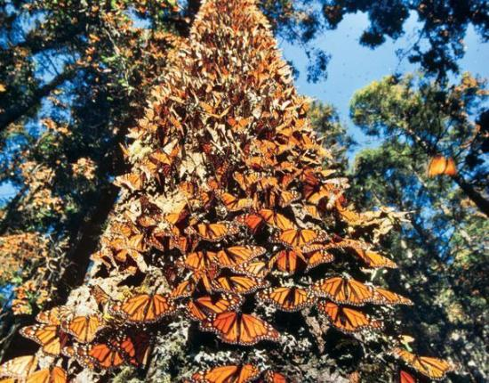
Why are monarchs declining?
Area in Mexico: 2013
Area in Mexico: 2015
Logging of winter habitat
Notes:
What’s driving these dramatic declines? One cause is logging. The monarchs roost in trees Mexico, but if the trees get cut down, then they don’t have the habitat that they need

Slide 6
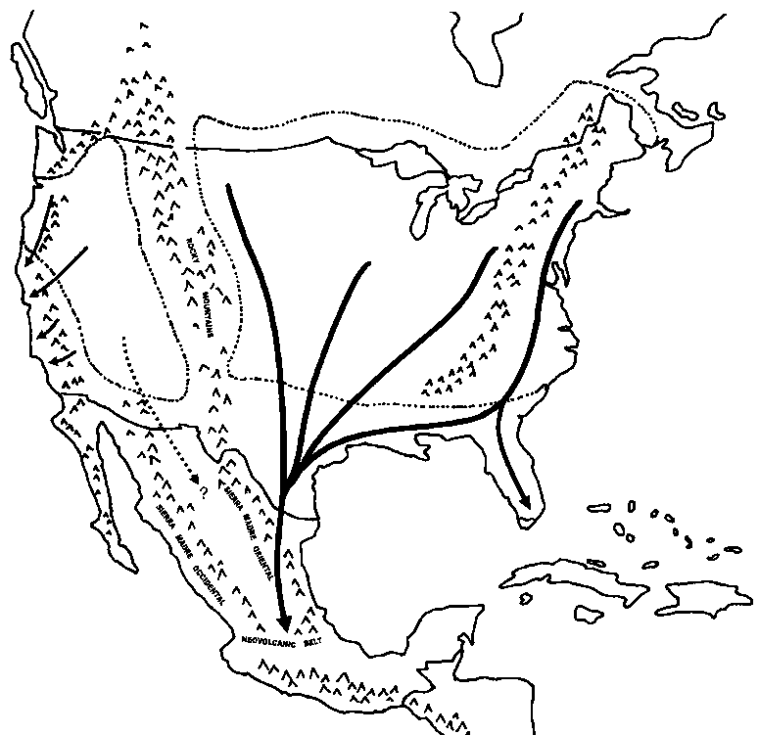
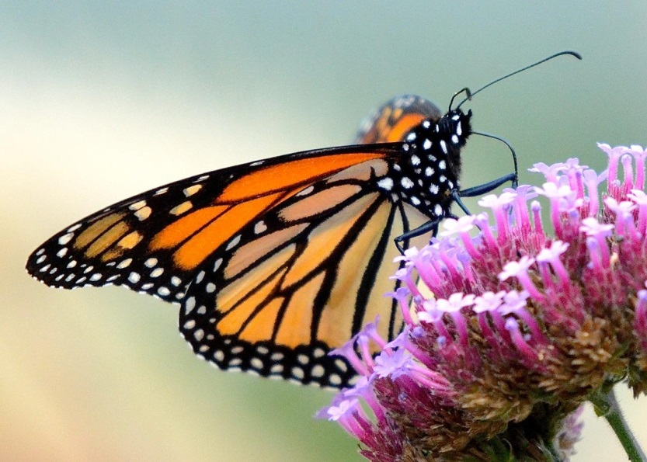
Why are monarchs declining?
Loss of nectar plants
FALL
Notes:
It takes a lot of food to make their 2500 mile journey! There are fewer flowering plants around for the monarchs to eat, so they can struggle to get enough food to reproduce and do the migration

Slide 7
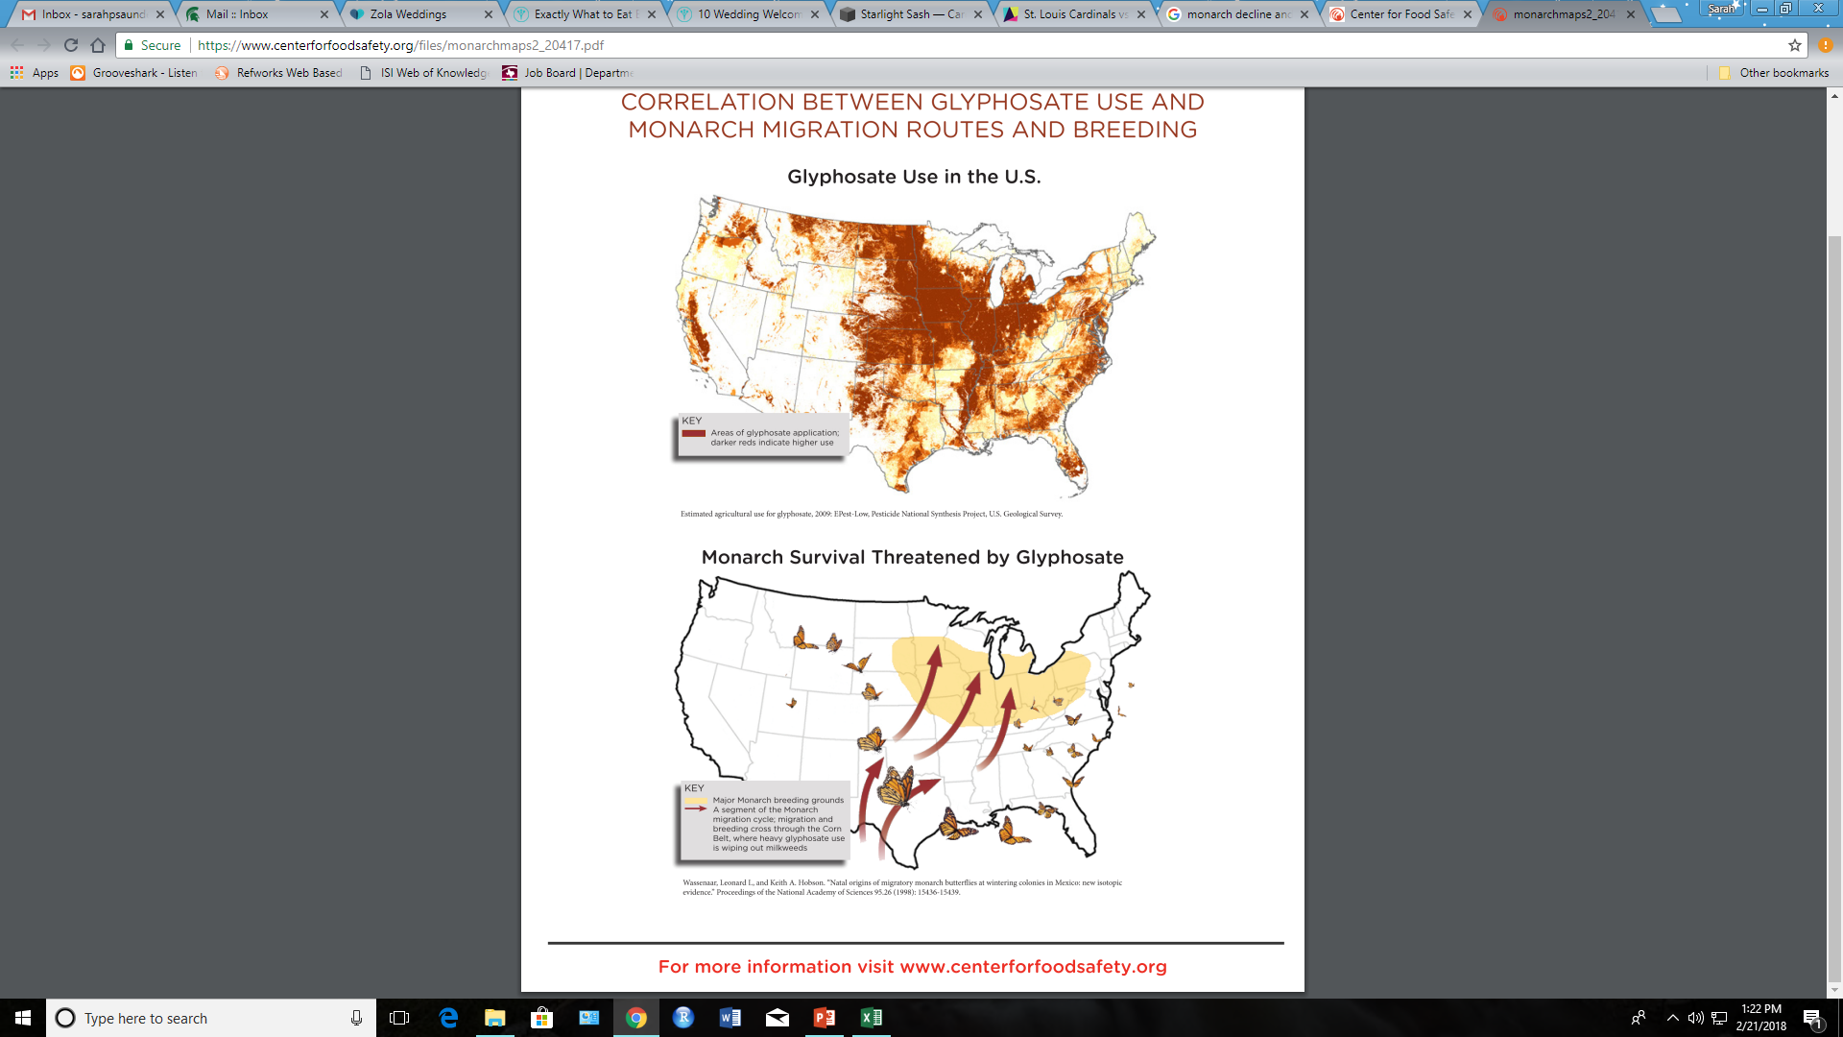
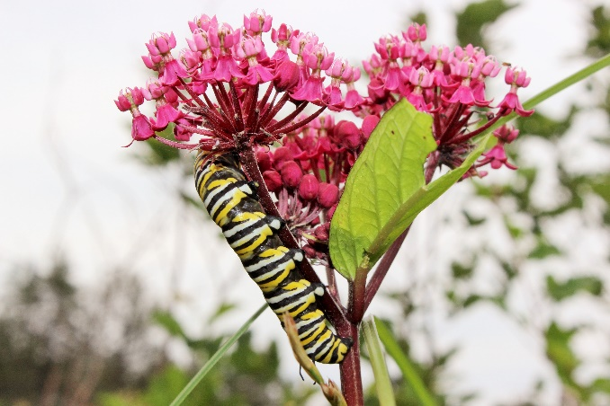
Why are monarchs declining?
Milkweed loss
Notes:
One particularly important plant for monarchs is milkweed. It has flowers for nectar, but more importantly, it’s what the adults lay their eggs on and what the caterpillars consume to grow. But milkweed used to grow in a log of agricultural areas, but the use of herbicides has resulted in less milkweed in the areas where the monarchs spend time.

Slide 8
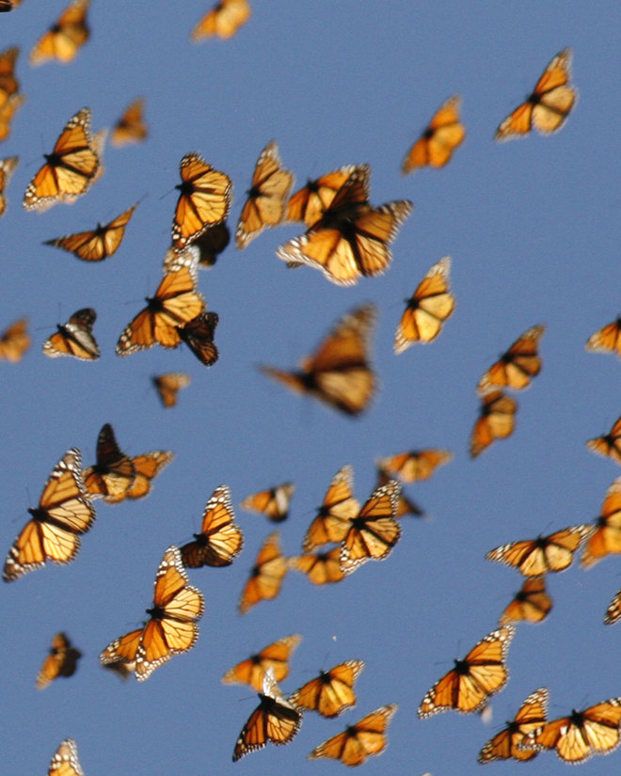
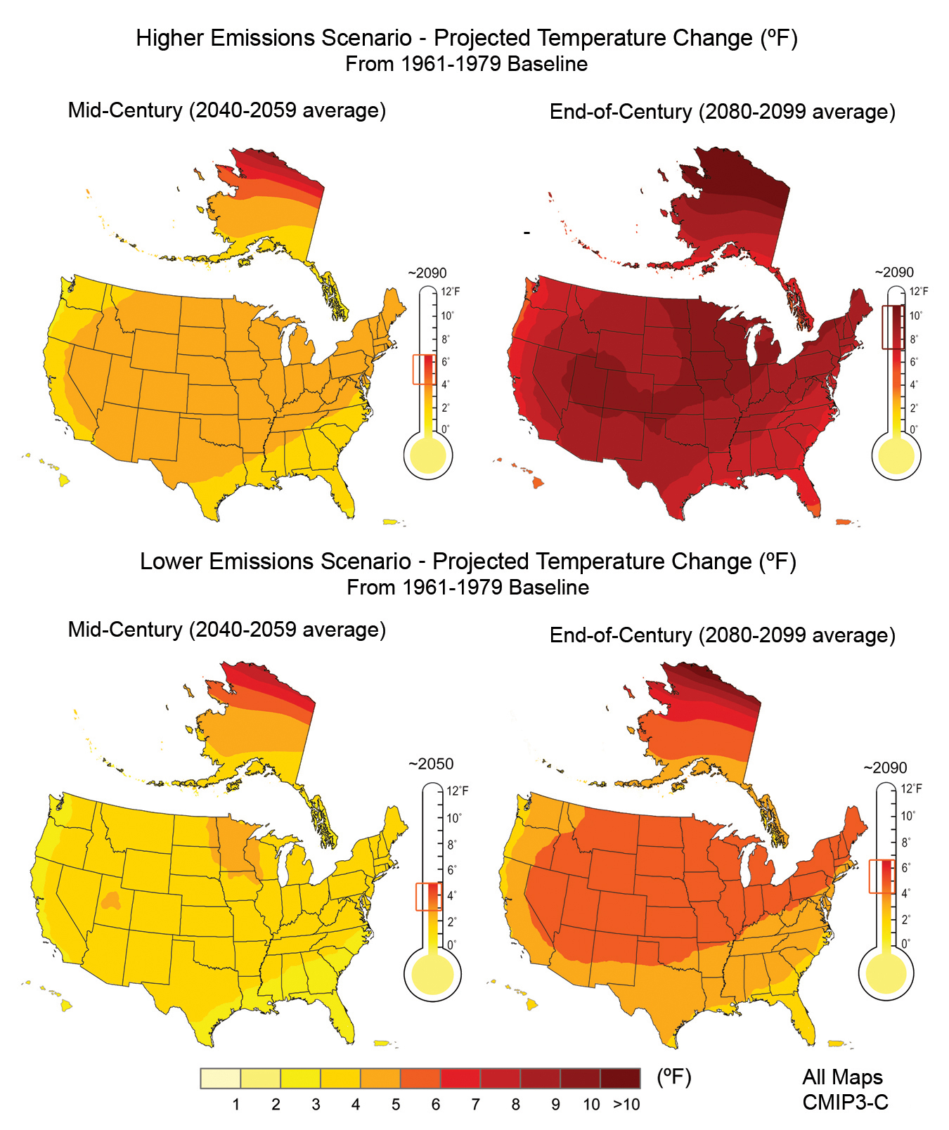
Why are monarchs declining?
Climate change
Notes:
Another really important reason why monarchs are declining is climate change. It’s getting hotter in the Midwestern US, and that can cause a lot of changes for butterflies. It can affect how they grow, whether the plants are ready when the caterpillars and butterflies need them, whether the climate is just too hot or other weather affecting them.

Slide 9
How can we use math to save monarchs?
Let’s use a model!
Notes:
So there’s a lot going on with the monarch butterflies! But the good news is that a lot of people care!
We have a lot of data about monarchs, all sorts of spreadsheets full of data. But how do we use those numbers to understand monarchs and figure out what to do next?

Slide 10
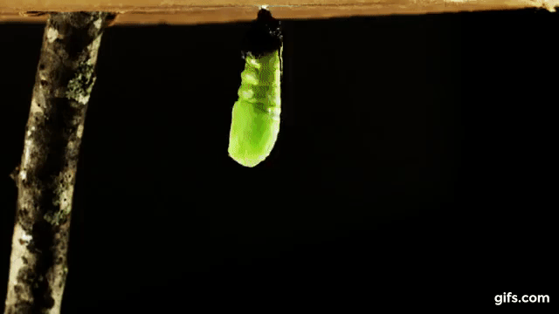
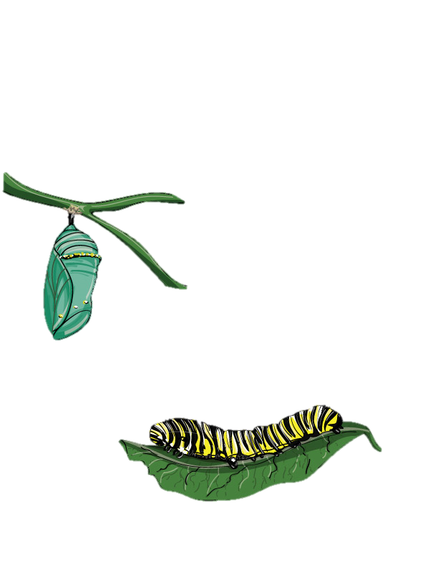
What are models?
Notes:
Anyone know What the picture is trying to say? (question time)
Yes, this picture describe the Monarch stages from a caterpillar, chrysalis, and to an adult butterfly. This is a complicated process (for higher grade: this is metamorphosis processes)
We can use these pictures to describe this complicated process. However, people can interpret these pictures differently. I can say the caterpillar is an alien but you can say that it is an insect.
So, just showing pictures is not the best way to let people describe this complicated process accurately in the same way.

Slide 11
Mathematical models
Using math to describe reality
Notes:
How can we describe this complex processes in a universal way? We use math!
Using math can allow us to simplify complicated processes in real world as models to have universal description among everyone.

Slide 12
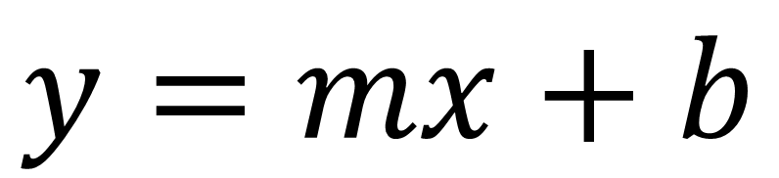
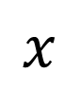
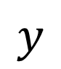
Mathematical models
$$y$$
$$x$$
$$y=mx+b$$
Notes:
We use math models to describe reality in a simple relationship between input and output, like the red line here demonstrates the relationship between input factor, x, and output factor, y.
We can see once we have more input x, there will be one more output y.
We then establish a math equation to describe the relationship, so everyone puts the same input in, we get the same output. That's how we can describe reality in a simple and universal way.

Slide 13
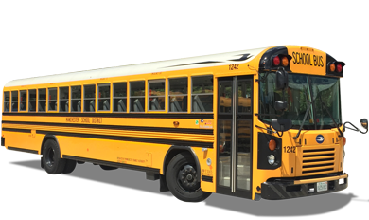
Uncertainty & statistics
Notes:
However, reality sometimes is more complicated than we can understand and expect.
For instance, school bus has scheduled time to pick you up and arrive at the school at eight.
Sometimes school bus gets late due to more traffic on rainy or cold days. Sometimes it gets earlier. Such uncertainties happen to most things in the real world.
To better describe how the real world works, we will also include uncertainty in math models. We will experience this uncertainty in latter practices

Slide 14


Models in ecology
How many individuals are there?
Where are these individuals located?
How is this population changing over time?
Notes:
Here, we can use math model to describe how many individuals of monarch at a single time period
and where are the monarch individuals located at as monarch population,
and finally using the same march model, we can describe this monarch population over multiple time periods to see how monarch population change over time

Slide 15
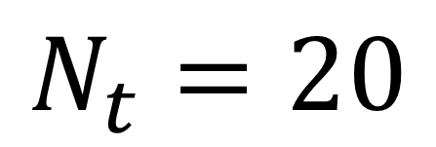
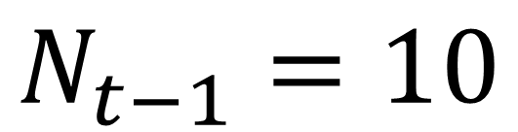
Population change
Population
Last Year
$$N_{t−1}=10$$
INCREASING!
Population
This Year
$$N_{t}=20$$
Notes:
How can we describe population change over time by the Monarch model?
First, we describe the number of individuals in the monarch population by N.
The little subscript t represents the time of year, like this year. t minus 1 represents one year before t, that is last year.
Now we can see the monarch population in last year, Nt-1, had 10 individuals and in this year Nt has 20 individuals.
We have ten more induvial this year, showing monarch population is increasing.

Slide 16
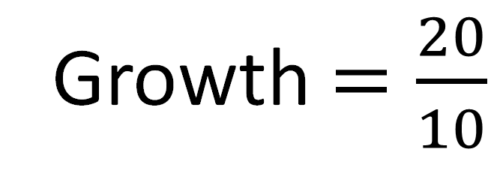
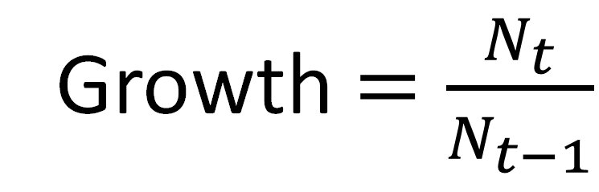
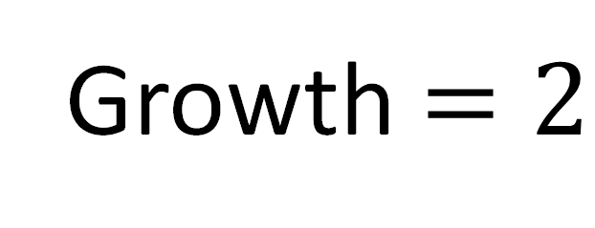
Population change
Growth $=\frac{N_{t}}{N_{t−1}}$
Growth $=\frac{20}{10}$
Growth $=2$
Notes:
We can use a simple math equation to describe the monarch population growth over time by calculating the ratio of number of individual in t, like this year, to the number of individual in t-1, like last year.
From the example, we have 20 individuals this year and 10 individuals last year. The ratio will be 20 divided by 10, that is equal to ? (Question time)
Yes, it's 2!

Slide 17
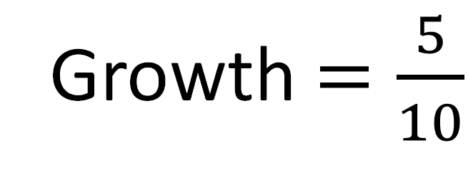
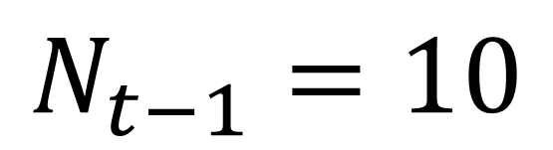
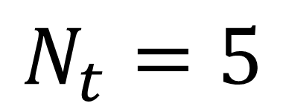
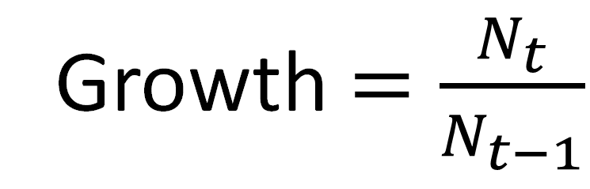
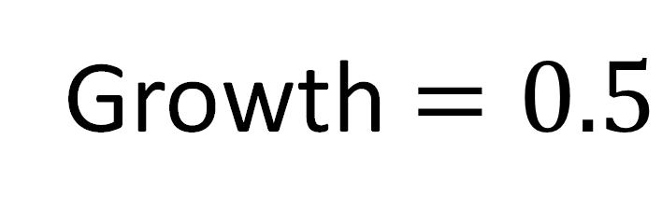
Population change
$$N_{t−1}=10$$
Growth $=\frac{N_{t}}{N_{t−1}}$
$$N_{t}=5$$
DECREASING!
Growth $=\frac{5}{10}$
Growth $=0.5$
Notes:
Now, when we have 10 individuals last year and five individuals this yea. The ratio is 5 divided by 10, equal to ? (Question time)
Yes, 0.5. It's showing monarch population growth is decreasing

Slide 18
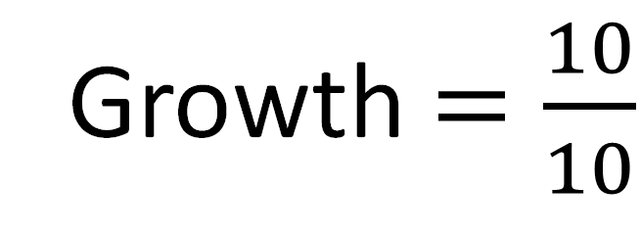
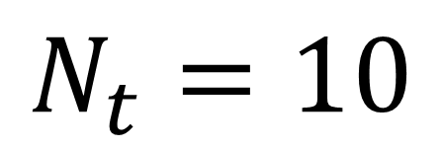
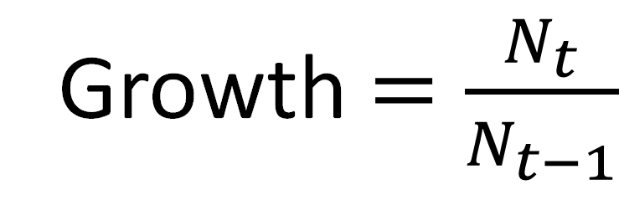
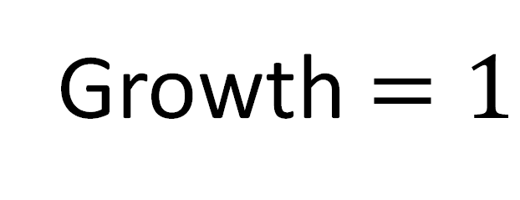
Population change
$$N_{t−1}=10$$
Growth $=\frac{N_{t}}{N_{t−1}}$
$$N_{t}=10$$
CONSTANT
Growth $=\frac{10}{10}$
Growth $=1$
Notes:
Now, when we have 10 individuals last year and 10 individuals this yea. The ratio is 10 divided by 10, equal to ? (Question time)
Yes, 1. It's showing monarch population growth is stay the same.

Slide 19
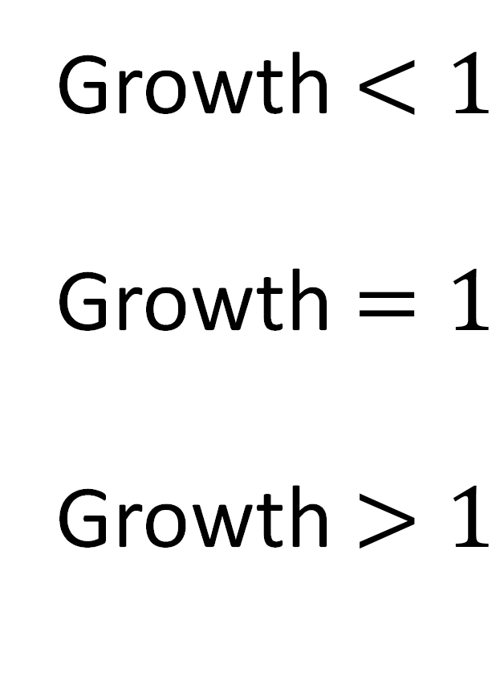
Population change
Growth $<1$
Growth $=1$
Growth $>1$
DECREASING
CONSTANT
INCREASING
Notes:
Therefore, using the simple equation of population growth, we can now describe monarch population change over time.
When population growth < 1, meaning ? (Question time). Yes, descreasing!
How about when population growth = 1, meaning ? (Question time). Yes, constant!
How about when population growth > 1, meaning ? (Question time). Yes, increasing!

Slide 20
Monarch module
Nectar plants
Winter forest habitat
Milkweed habitat
Climate change
Notes:
Now we are going to take all of the pieces that are impacting monarchs to look at how monarch population might change in the future if we want to protect them.

Slide 21
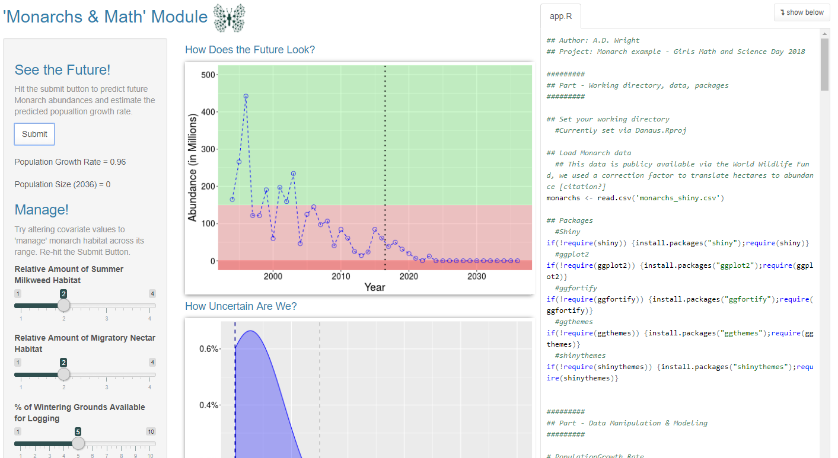
Monarch module
https://danaus.shinyapps.io/Danaus/
Run Module
Inputs
Outputs
Fill out the exercise sheet by interacting with the web app
Answer Q’s on the back!
Notes:
Everyone now goes to this website, let's read the worksheet and then let's get to work!

Slide 22
What did we find out?
Did all your iterations of the scenarios turn out the same?
What scenarios are bad for monarchs?
What scenarios are good for monarchs?
Do you have any questions?

Slide 23
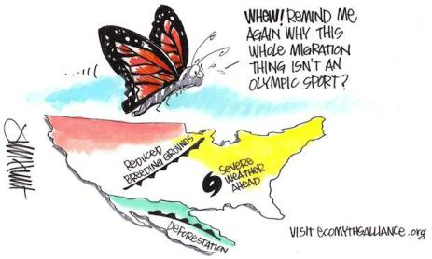

What can you do to help?
Make an area of your yard a monarch habitat!
Plant milkweed & nectar plants
Spread the word!

